Slide 1
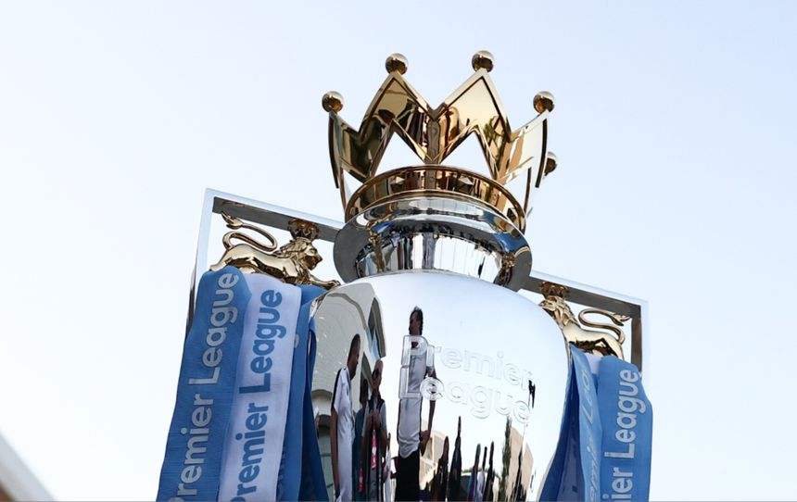

TOP GOAL SCORER
Name :- Chidumulla Sai Pavan Reddy
Mentor :- Nalla Suman
Organization :- Infosys Springboard Internship
Duration :- 6 Aug – 10 Oct

Slide 2
PROJECT OVERVIEW
To build a predictive web app that forecasts:
The Top Goal Scorer(Player-level prediction)
Goal: Use machine learning models and Streamlit to make football analytics accessible and interactive.

Slide 3
SYSTEM ARCHITECTURE
Workflow:
Dataset (CSV): Contains past Premier League statistics
Exploratory Data Analysis:
Model Training (Jupyter Notebook): Machine learning algorithms trained on data
Saved Models (.pkl): Logistic Regression & Linear Regression models
Frontend (Streamlit App): Interactive interface for predictions
Data collection
EDA
Model Training
Model Refining
Model deploying

Slide 4
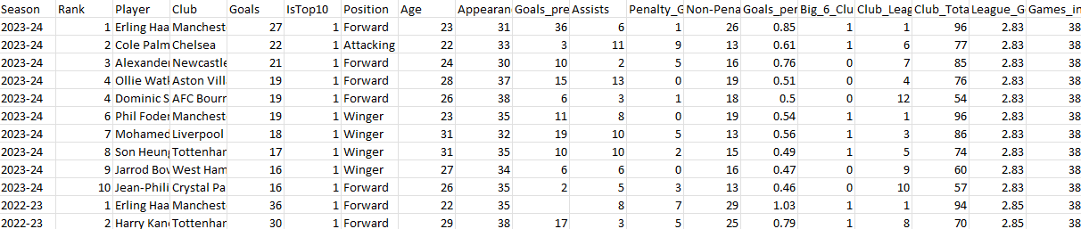
DATASET DETAILS
File: Top Goals.csv Features (for Top Goal Scorer Model):
Season, Rank, Player, Club, Goals, IsTop10, Position, Age, Appearances, Goals_prev_season, Assists, Penalty_Goals, Non-Penalty_Goals, Goals_per_90, Big_6_Club_Feature, Club_League_Rank, Club_Total_Goals, League_Goals_per_Match, Games_in_Season
Target Variable:
Whether the team won the league (1 = Yes, 0 = No)

Slide 5
MODEL BUILDING (Backend - .ipynb)
Tools Used:
Python (Pandas, NumPy, Label Encoder, Scikit-learn)
Random Forest Regressor(Model used)
Process:
Data preprocessing & cleaning
Feature selection
Train-test split
Model training
Model evaluation (Accuracy / R² score)
Saving model with joblib

Slide 6
Top Goal Scorer Prediction Model
Input Features: Age, Appearances, Goals in Previous Season, Goals Per 90 mins, Big 6 Club Feature(0/1), League Goals per Match, Player Position(encoded) Output: Goals according to Input Features Example Output:
Number of Goals: 10

Slide 7
STREAMLIT FRONTEND
Framework Used: Streamlit Features:
Two options: Top Goal Scorer & League Winner
Interactive input fields
Real-time model predictions
Stylish results display (colored boxes, sample tables)
Tech Stack:
Python, Streamlit, Joblib, Pandas, Scikit-learn

Slide 8
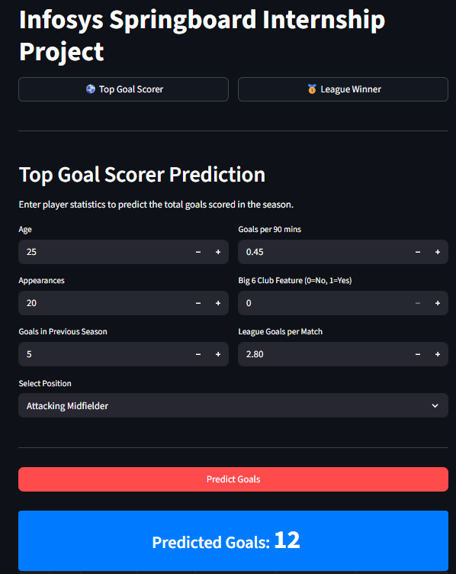
APP UI

Slide 9
RESULTS AND INSIGHTS
Example Insights:
Player’s previous season goals & club type strongly affect goal predictions.
Model Performance (optional):
Random Forest Accuracy: 0.92
Logistic Regression Accuracy: 0.90
Decision Tree Regressor: 0.91
Support Vector Machine: 0.72

Slide 10
ACKNOWLEDGMENTS
I would like to express my sincere gratitude to Mr. Nalla Suman, my trainer and mentor, for his continuous guidance, support, and valuable feedback throughout the course of this project. His encouragement and insights helped me understand and implement machine learning concepts effectively.
I would also like to thank Infosys Springboard for providing this opportunity to work on an exciting and practical project that enhanced my technical and analytical skills.
Finally, I appreciate the use of open-source tools and resources such as Kaggle, Scikit-learn, and Streamlit that made this project possible.

